Slide 1
Sprint 1 Retrospective
SEP Team 5

Slide 2
Things That We Did Well

Slide 3
Stable and Robust Project Foundation
Proactive fixes of unmaintainable code over temporary fixes to complete sprint
Thoroughly documented wiki pages and processes

Slide 4
Pro-active Roadblock Removal
Strong database schema and creation during sprint 1
Robust component creation for re-use in future sprints

Slide 5
Strong Product Owner Communication
Feedback on story acceptance in < 24 hours of completion
Notes:
What Went Right

Slide 6
Things That We Didn’t Do Well

Slide 7
MVP Task Delivery Time
Local database setup was delayed until late Saturday night, 2nd week
Initial front end tasks were delayed until mid second week

Slide 8
Pull Request Review Response Time
Pull requests went for up to 3 days without being receiving initial review
Notes:
What Went Wrong and Can Be Improved

Slide 9
Late Project Set-up and Dependency Adding
Frameworks (i.e. React/Joi/TypeORM) were delayed into the later half of the sprint
Unexpected dependencies due to late set up to avoid duplicate work

Slide 10
Team Member Capacities
Initial estimates of capacity did not include time dedicated to test plan documents, presentations, etc.
Scrum Master duties cut into development time

Slide 11
Story and Feature Break Down
X4 - 1 point
X1 - 2 Point
X4 - 3 point
X2 - 5 Point
X2 - 8 Points
Total: 45 Points

Slide 12
Story and Feature Break Down
Continuous Integration Set-Up (Included Code Coverage set up)
Log In (Included Testing and React set up)
Log in Backend (Included Testing and Enzyme set up)
Database set up (Included orm set up)

Slide 13
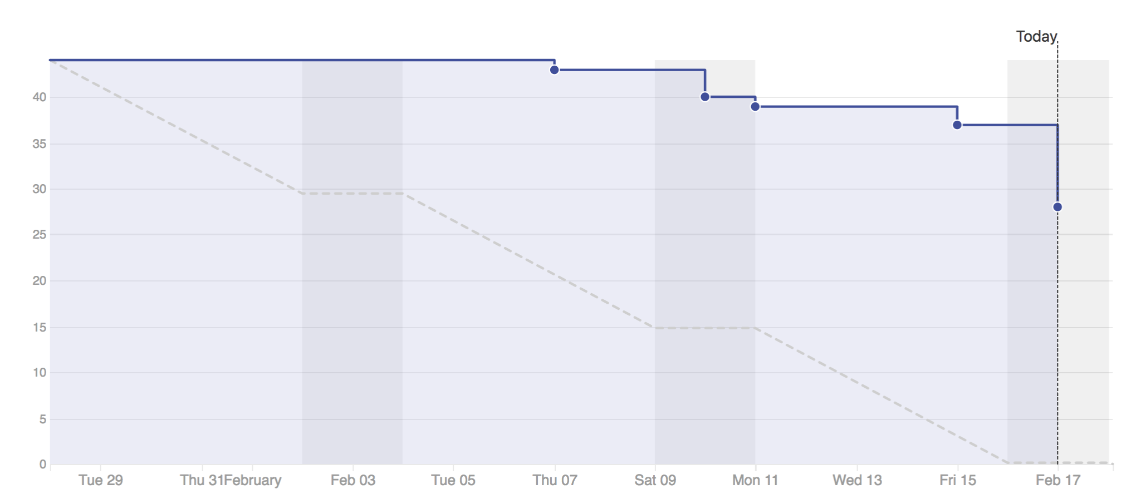
Burn Down Rate

Slide 14
Interteam Communication
Minor confusions about tasks and errors that weren’t brought up until scrum meetings

Slide 15
Actions We’ll Take to Improve Next Sprint

Slide 16
MVP Task Delivery Time
Break tasks even smaller to encourage faster delivery of smaller parts

Slide 17
Pull Request Review Response Time
Reminders of open pull requests are now a part of our scrum meetings
Notes:
How We’re going to Fix what went wrong / what will we commit to next sprint

Slide 18
Late Project Set-up and Dependency Adding
Dependency setups are going to be in separate tasks/pull requests
Most of the dependencies are already added, so future dependency adding will be limited

Slide 19
Team Member Capacities
Before assigning workload capacity, review the class schedule and our own schedules

Slide 20
Story and Feature Break Down
Research tasks in advance before accepting or creating the stories
Put more details into what exactly we want for a story before beginning it to prevent feature creep

Slide 21
Interteam Communication
Encourage team to post errors and seek for help as soon as issues arise

Slide 22
Burn Down Rate Catch Up
Break tasks up into more manageable chunks to encourage smaller features being accepted sooner

Slide 23
Outcome

Slide 24
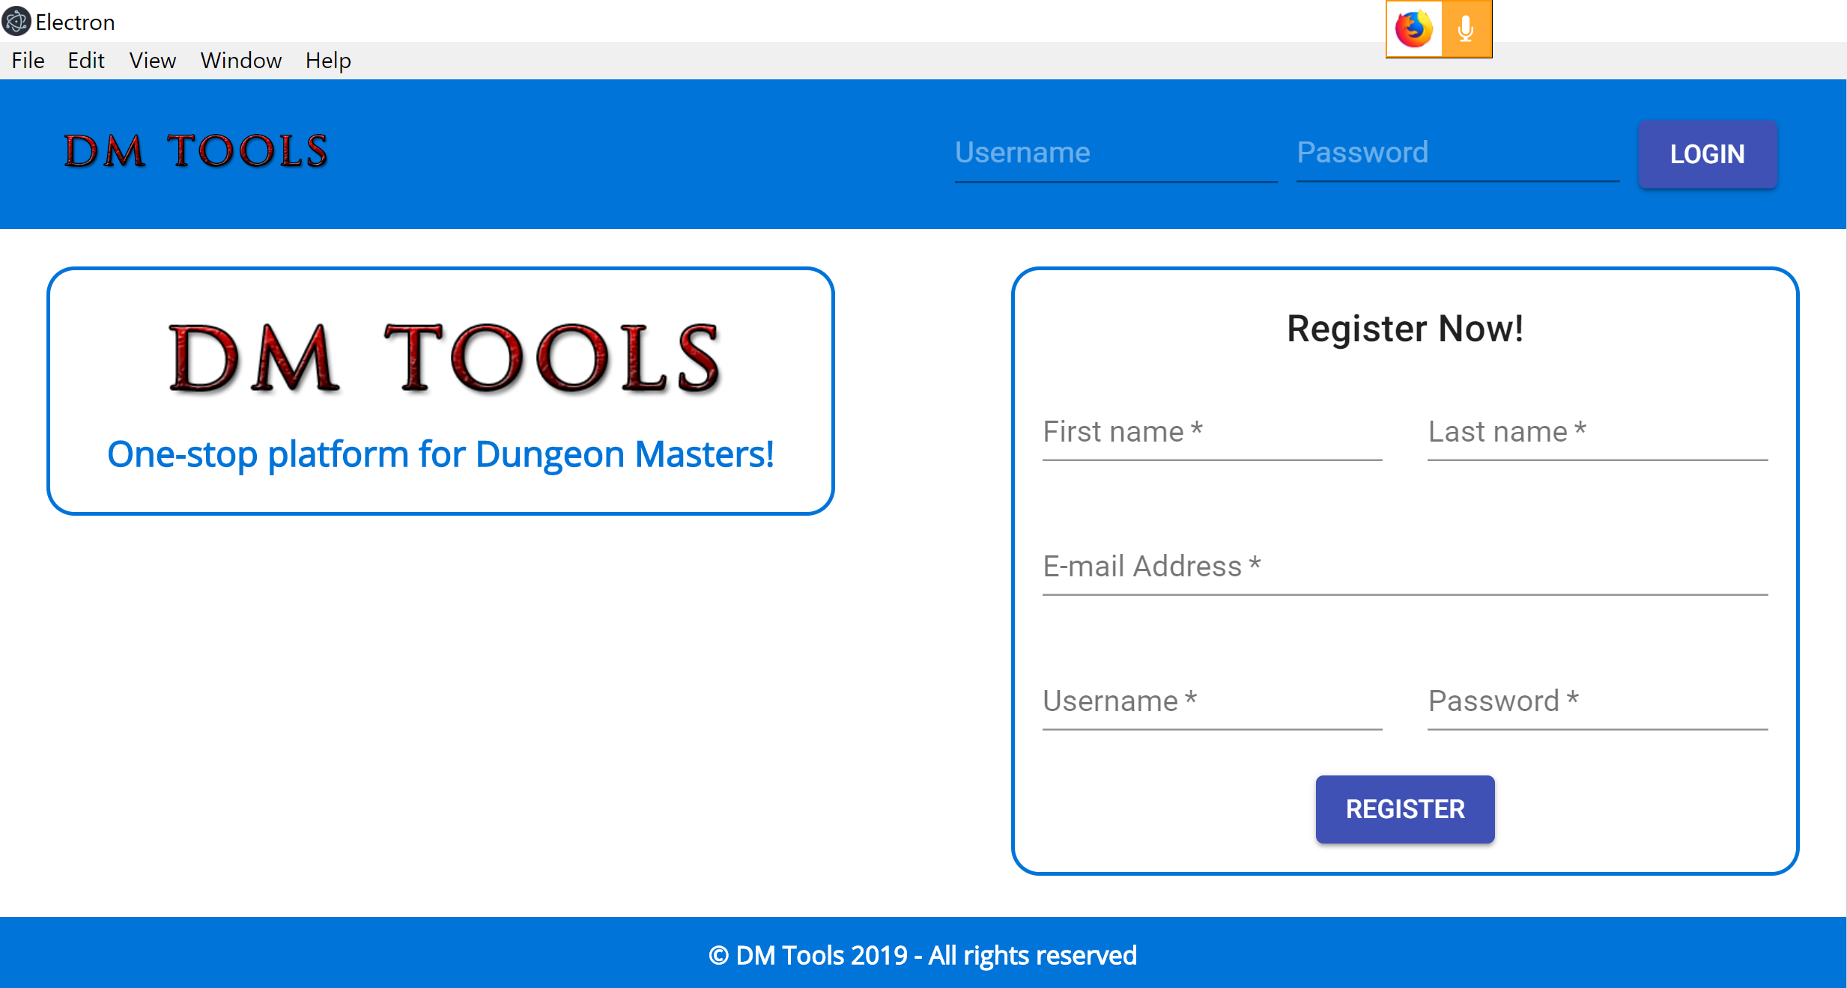
Landing / Registration / Login Page

Slide 25
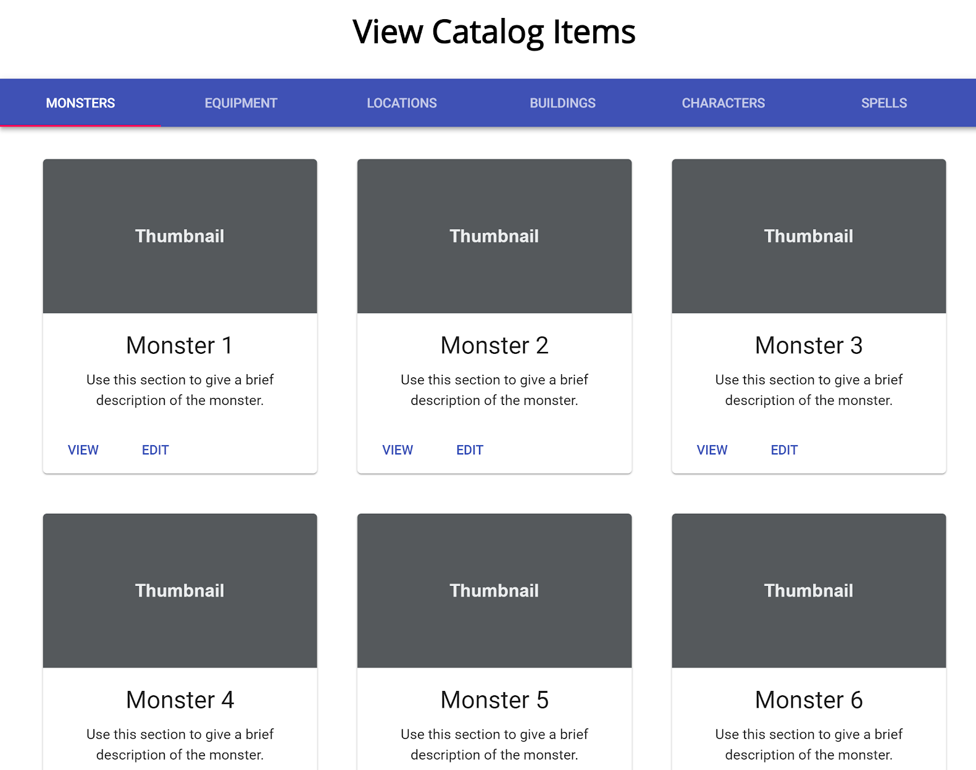
View Game Catalogue / Monsters Gallery

Slide 26
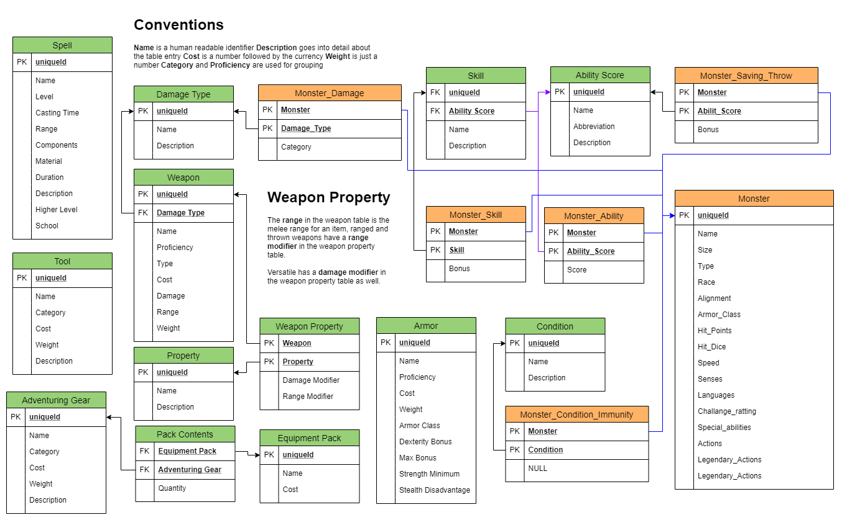
Database Set Up

Slide 27
Questions?

